Slide 1
UNNAT BHARAT ABHIYAN
उन्नत
भारत
अभियान

Slide 2
UNNAT BHARAT ABHIYAN
Stakeholders of Rural Development
Government of India
State Government
District Administration
District Panchayat Office
Taluka Panchayat Office
Gram Panchayat
Villagers
Participating Institute ( Faculty members, Staff members & Students)
Subject Expert Groups
Voluntary Organizations
NGOs

Slide 3
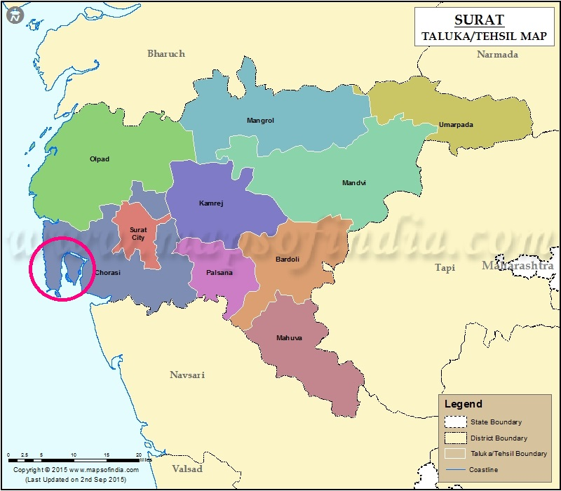
ADMINISTRATIVE & POLITICAL STRUCTURE

Slide 4
Surat District Administrative Wing
Surat District Political Wing
Dr. Dhavalkumar Patel, I.A.S. Shri. Hitesh Koya
Collector, Surat District Development Officer, Surat
Shri. G. M. Barod
Taluka Development Officer,
Choryasi Taluka, Surat District
Shri Sunilbhai Desai
Talati Shri
Juangam, Suvali, Rajagari Village
Smt. Jahnvaiben Bhatt
Inch. Talti Shri
Bhatlai Village
Shri Devendrabhai Patel
Talati Shri
Mora Village
Smt. Pritiben Patel
President, Surat District Panchayat
Shri Dalpatbhai Patel
President of Choryasi Taluka Panchayat
Shri. Bhagubhai Patel
Sarpanch Shri, Junagam Village
Smt. Nayanaben Patel
Sarpanch Shri, Suvali Village
Smt. Rinaben Patel
Sarpanch Shri, Bhatlai Village
Shri. Chhotubhai Patel
arpanch Shri, Bhatlai Village
Smt. Ranjanben Patel
Sarpanch Shri, Mora Village

Slide 5
Surat Distrcit Panchayat Organization Structure Source: https://suratdp.gujarat.gov.in/surat/

Slide 6
Branches of District Panchayat
Revenue Branch -મહેસૂલ શાખા
Development Branch -વિકાસ શાખા
Panchayat Branch -પંચાયત શાખા
Construction Branch -બાંધકામ શાખા
Irrigation Branch -સિંચાય શાખા
Statistics Branch -આંકડા શાખા
Health Branch -આરોગ્ય શાખા
Education Branch -શિક્ષણ શાખા
Pastoral Branch - પશુપાલન શાખા
Social Welfare Branch - સામાજિક કલ્યાણ શાખા
Co-Operation Branch - સહકાર શાખા
Farming Branch - ખેતીવાડી શાખા
Integrated Child Development Branch -સંકલિત બાળવિકાસ શાખા
Family Welfare Branch - કુટુંબ કલ્યાણ શાખા
Ayurveda Branch - આયુર્વેદ શાખા
Malariya Branch - મલેરિયા શાખા
Accounting Branch - આંકડા શાખા
Establishment Branch - મહેકમ શાખા

Slide 7
District Rural Development Agency
Mission
Sustainable and inclusive growth of rural Gujarat through a multi-pronged strategy for eradication of poverty by increasing livelihood opportunities, developing infrastructure, giving access to improved sanitation facilities and generating employment opportunities for growth and improvement of quality of life in rural Gujarat.
Vision
Sustainable and inclusive growth of rural Gujarat
SCHEMES
Mhatma Gandhi National Rural Employment Guarantee Act (MGNREGA)
Swachh Bharat Mission – Grmain
Pradhan Mantri Awas Yojana
Integrated Watershed Management Program (IWMP)
Mission Mnagalam
Website: https://ruraldev.gujarat.gov.in/index.htm

Slide 8
Contact Information
UNNAT BHARAT ABHIYAN
Website: http://unnatbharatabhiyan.gov.in/
Email address: unnatbharatabhiyaniitd@gmail.com
Prof. Virendra Kr. Vijay
National Coordinator,
Unnat Bharat Abhiyan
Room No. 376, Block-III,CRDT, Indian Institute of Technology Delhi,
Hauz Khas, New Delhi-110016
Regional Coordinating Institute SVNIT Surat
Dr. K. D. Yadav Dr. Manish K. Rathod Er. Jaydip N. Vora
UBA Regional Coordinator UBA Regional Co-coordinator UBA Manager
✆: +91 94283 98266 ✆: +91 99040 03856 ✆: +91 75674 24651
Email Address: rciuba@svnit.ac.in
Website: http://svnit.ac.in/Unnat_Bharat/
Ph.: 0261 220 4303
Address: 307, New CRC, SVNIT, Ichchhanath, Dumas Road, Surat

